Slide 1

Maekawa’s Algorithm: Key Idea
Ricart-Agrawala requires replies from all processes in group
Maekawas Algorithm instead, get replies from only some processes in group
But ensure that only one process is given access to CS (Critical Section) at a time
https://cseweb.ucsd.edu/classes/wi09/cse223a/p145-maekawa.pdf
Notes:
https://cseweb.ucsd.edu/classes/wi09/cse223a/p145-maekawa.pdf

Slide 2

Maekawa’s Algorithm
Permission obtained from only a predecided subset of other processes, called the Request Set (or Quorum)
Separate Request Set, R_{i}, for each process i
Requirements:
    for all i, j: R_{i} ∩ R_{j} ≠ Φ
    for all i: i Є R_{i}
    for all i: |R_{i}| = K, for some K
    any node i is contained in exactly D Request Sets, for some D

Slide 3
Maekawa’s Algorithm
The processes in the intersection of the request sets of two processes Pi and Pj, will intercede to decide who of the two should enter as they are aware of both Pi and Pj being interested.

Slide 4
A Simple Version
To request critical section:
    i sends REQUEST message to all process in R_{i}
On receiving a REQUEST message:
    Send a REPLY message if no REPLY message has been sent since the last RELEASE message is received.
    Update status to indicate that a REPLY has been sent.
    Otherwise, queue up the REQUEST
To enter critical section:
    i enters critical section after receiving REPLY from all nodes in R_{i}

Slide 5
A Simple Version contd..
To release critical section:
    Send RELEASE message to all nodes in R_{i}
    On receiving a RELEASE message, send REPLY to next node in queue and delete the node from the queue.
    If queue is empty, update status to indicate no REPLY message has been sent.
  Algorithm silent about who the next node should be who reply is sent to..is it next node in queue or process with lowest time stamp.

Slide 6
Quorum Based Algorithms
{Maekawa’s algorithm}
- First solution with a sublinear O(sqrt N) message complexity.
- “Close to” Ricart-Agrawala’s solution, but each process is required to obtain permission from only a subset of peers

Slide 7
Maekawa’s algorithm
With each process i, associate a subset S_{i}. Divide the set of processes into subsets that satisfy the following two conditions:
i ∈ S_{i}
∀i,j : 0≤i,j ≤ n-1 S_{i} ⋂ S_{j} ≠ ∅
Main idea. Each process i is required to receive permission from S_{i} only. Correctness requires that multiple processes will never receive permission from all members of their respective subsets.
S₀
S₁
0,1,2
1,3,5
2,4,5
S₂

Slide 8
Maekawa’s algorithm
Example. Let there be seven processes 0, 1, 2, 3, 4, 5, 6
S₀ = {0, 1, 2}
S₁ = {1, 3, 5}
S₂ = {2, 4, 5}
S₃ = {0, 3, 4}
S₄ = {1, 4, 6}
S₅ = {0, 5, 6}
S₆ = {2, 3, 6}

Slide 9
Maekawa’s algorithm
Version 1 {Life of process I}
1. Send timestamped request to each process in S_{i}.
2. Request received → send ack to process with the lowest timestamp. Thereafter, "lock" (i.e. commit) yourself to that process, and keep others waiting.
3. Enter CS if you receive an ack from each member in S_{i}.
4. To exit CS, send release to every process in S_{i}.
5. Release received → unlock yourself. Then send ack to the next process with the lowest timestamp.
S₀ = {0, 1, 2}
S₁ = {1, 3, 5}
S₂ = {2, 4, 5}
S₃ = {0, 3, 4}
S₄ = {1, 4, 6}
S₅ = {0, 5, 6}
S₆ = {2, 3, 6}

Slide 10
Maekawa’s algorithm-version 1
ME1. At most one process can enter its critical section at any time.
Let i and j attempt to enter their Critical Sections
S_{i} ∩ S_{j} ≠ ∅ implies there is a process k ∊ S_{i} ⋂ S_{j}
Process k will never send ack to both.
So it will act as the arbitrator and establishes ME1
S₀ = {0, 1, 2}
S₁ = {1, 3, 5}
S₂ = {2, 4, 5}
S₃ = {0, 3, 4}
S₄ = {1, 4, 6}
S₅ = {0, 5, 6}
S₆ = {2, 3, 6}

Slide 11
Maekawa’s algorithm-version 1
Is deadlock possible ??

Slide 12
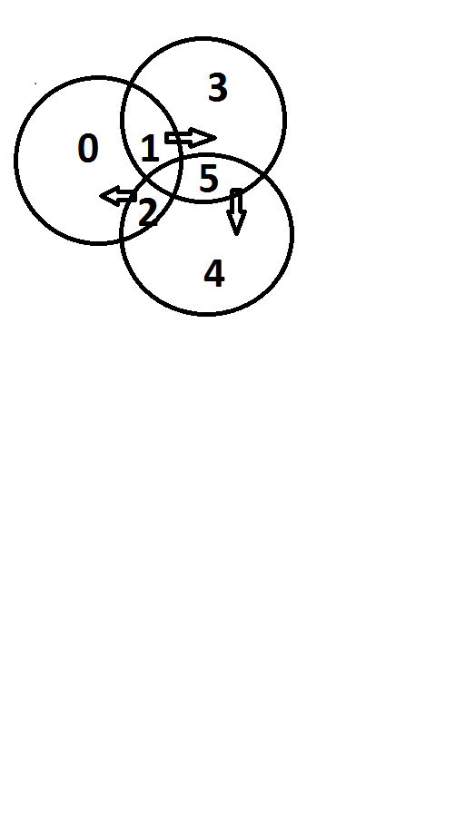
Data Structures Week 1
1
0
2
0 waits on process 1,
Process 1 on process 2 (process5)
process 2 on process 0

Slide 13
Maekawa’s algorithm-version 1
ME2. No deadlock. Unfortunately deadlock is possible! Assume 0, 1, 2 want to enter their critical sections.
From S₀= {0,1,2}, 0,2 send ack to 0, but 1 sends ack to 1;
From S₁= {1,3,5}, 1,3 send ack to 1, but 5 sends ack to 2;
From S₂= {2,4,5}, 4,5 send ack to 2, but 2 sends ack to 0;
Now, 0 waits for 1 (to send a release), 1 waits for 2 (to send a release), , and 2 waits for 0 (to send a release), . So deadlock is possible!
S₀ = {0, 1, 2}
S₁ = {1, 3, 5}
S₂ = {2, 4, 5}
S₃ = {0, 3, 4}
S₄ = {1, 4, 6}
S₅ = {0, 5, 6}
S₆ = {2, 3, 6}

Slide 14

Features
Message Complexity:
Synchronization delay =
    2*(max message transmission time) [since a release request and a reply to next queued request to be done.]
Major problem: DEADLOCK possible
Need three more types of messages (FAILED, INQUIRE, YIELD) to handle deadlock.
    Message complexity can be 5*sqrt(N)

Slide 15
Maekawa’s algorithm-Version 2
Avoiding deadlock
If processes always receive messages in increasing order of timestamp, then deadlock “could be” avoided. But this is too strong an assumption.
Version 2 uses three additional messages: At site Sk
- failed (if reply already given to someone else with higher priority)
- inquire: An inquire msg is sent by Sk when a higher priority request has reached it( to check if the request granted process Si is already in CS ). If Si has received a failed from someone else then Si will respond with a yield to Sk. Then, Sk will put Si on the queue to allow his request at a later point and will reply to the site with higher priority.

Slide 16
Maekawa’s algorithm-Version 2
- Yield (process got failed from one of the other processes so it relinquishes its desire to enter CS for now)
However if it is already in CS, it will send RELEASE only after finishing CS.s
Notes:
Time 13:38 of Lecture 15

Slide 17
Maekawa’s algorithm-Version 2
New features in version 2
Send ack and set lock as usual.
If lock is set and a request with a larger timestamp arrives, send failed (you have no chance). If the incoming request has a lower timestamp, then send inquire (are you in CS?) to the locked process.
- Receive inquire and at least one failed message → send relinquish. The recipient resets the lock.
S₀ = {0, 1, 2}
S₁ = {1, 3, 5}
S₂ = {2, 4, 5}
S₃ = {0, 3, 4}
S₄ = {1, 4, 6}
S₅ = {0, 5, 6}
S₆ = {2, 3, 6}
Contact

